Slide 1
Physics Lab experiments
2015, 2nd term
By
Dr. Tamer Fathy Ghanem

Slide 2
Lab 1: Basics

Slide 3
AC & DC signals

Slide 4
DC & AC signals

Slide 5
Voltage and Voltage difference
4
A
V₄ = 9 v
1 K
V₄₃ = 1 v
3
V₃ = 8 v
V_{AB} = 9 volts
6 K
V₃₂ = 6 v
2
V₂ = 2 v
2 K
V₂₁ = 2 v
1
B
V₁ = 0 v
0 volts

Slide 6
Voltage and Voltage difference
4
A
V₄ = 7 v
1 K
V₄₃ = 1 v
3
V₃ = 6 v
V_{AB} = 9 volts
6 K
V₃₂ = 6 v
2
V₂ = 0 v
2 K
V₂₁ = 2 v
1
B
V₁ = -2 v
0 volts

Slide 7
Lab 2: Resistors

Slide 8
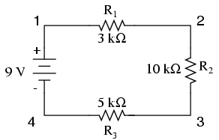
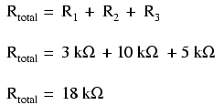
Series circuits

Slide 9
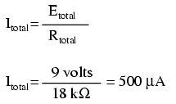
Series circuits

Slide 10
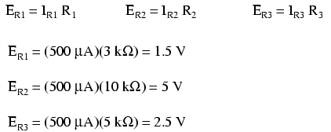
Series circuits

Slide 11
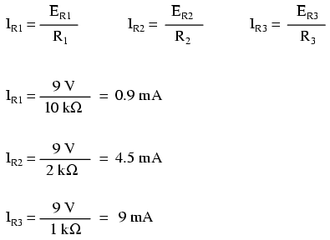
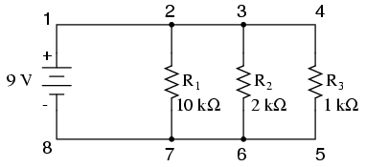
Parallel circuits

Slide 12
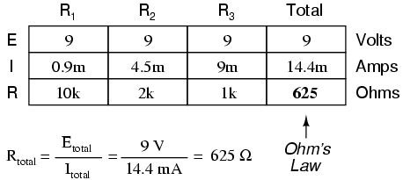

Parallel circuits

Slide 13
Parallel circuits

Slide 14
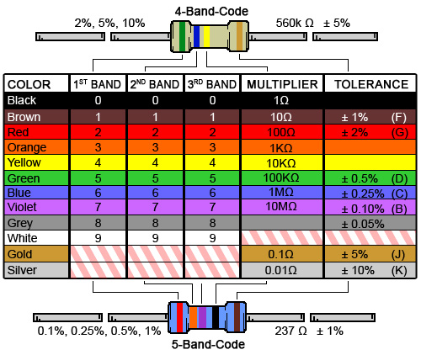
Color code

Slide 15
Experiment
+
2.2 k
_
A
+
R₁
V
6 volts
R₂
1 K
_
 | Calculated |  | Practical
 | R1 | R2 | R1 | R2
I (A) | ? | ? |  | ?
V (Volt) | ? | ? |  | ?
Experiment
Results

